Slide 1

CCS6354: Blockchain & Smart Contract​
NFT TICKETING SYSTEM
Group Z (TC1L / TT1L)

Slide 2





Group members
Aisyah Binti Ahmad Komarolaili
Bibi Nurhusnina Binti Mustag Ahmad
Mohammed Aamena Mohammad AbdulKarem
Vashti Vinodhini Anbusamy
1211101519
1221101181
1221305728
1221101168

Slide 3

Introduction
BACKGROUND
Current ticketing system’s drawbacks - fake tickets, scalping, unclear resale practices, and lack of regulatory oversight.
NFTs, offer verifiable ownership, authenticity, and transparent resale using smart contracts.
PROBLEM STATEMENT
OBJECTIVES
Scalability & transaction latency on blockchains
User onboarding difficulties with wallets and private keys
Regulatory uncertainty around resale rights and consumer protection
Fraudulent resale & scalping without transparent resale controls
Ensure authentic, tamper-proof tickets
Enable fair, smart contract-based resale
Provide full lifecycle control to organizers

Slide 4
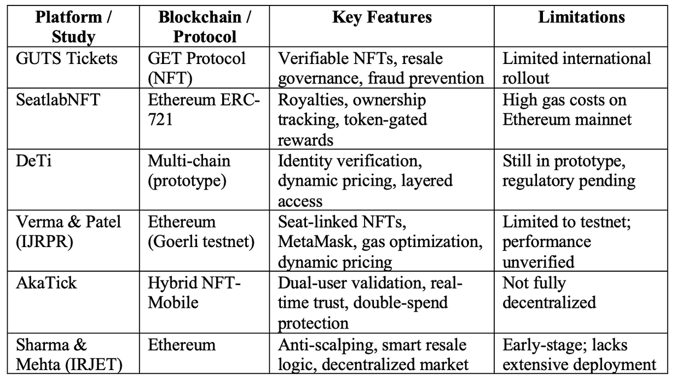

Literature Review
Identified Research Gaps
User Onboarding Complexity
Scalability Limitations
Regulatory Uncertainty
Technical Infrastructure

Slide 5
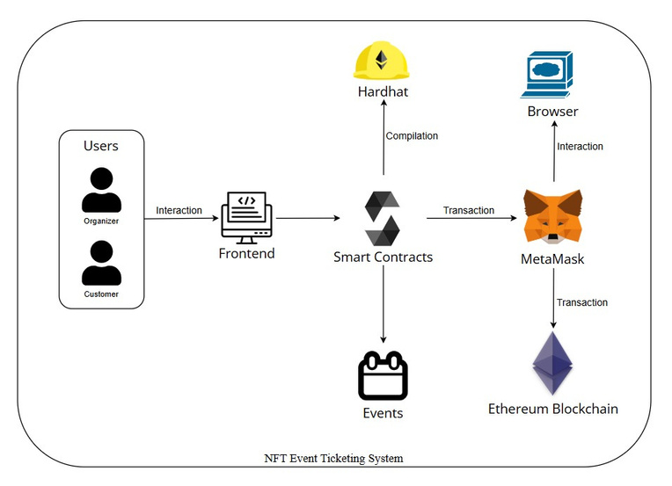




Methodology
System Architecture
Technology Stack
1. Smart Contract Layer
Solidity-based contracts implementing ERC-721 standard with factory pattern for dynamic event deployment Solidity v0.8.21 + OpenZeppelin
2. Frontend Interface
ReactJS application with responsive UI, MetaMask integration for wallet authentication
ReactJS + Tailwind CSS + Ethers.js
3. Blockchain Environment
Local development with Hardhat, IPFS storage for metadata, comprehensive testing suite
Hardhat + IPFS + Pinata API
Development & Deployment Process
Local Development
Smart Contract Testing
Frontend Integration
System Validation

Slide 6

Research Result
B. Performance Metrics
Gas used for each function
Function | Result
Create Events | Passed
Set Event Stage | Passed
Buy Ticket | Passed
Cancel Event / Cancel Resale | Passed
View Ticket | Passed
Buy Resale Ticket | Passed
Passed
Passed
Passed
Passed
Passed
Passed
A. Functional Testing Outcomes

Slide 7
Analysis & Interpretation
KEY FINDINGS
DAPP IMPLEMENTATION SUCCESS
PROVEN BLOCKCHAIN PRINCIPLES
Transparency:
Immutable metadata stored on IPFS
Fully transparent resale market
Security:
All transactions conducted via MetaMask
Decentralization:
No reliance on central server for ticketing
NFT Minting of tickets
Ownership visible in wallet and My Tickets
Resale preserves original metadata

Slide 8

Discussion
Tackled Key Challenges
Limitations
The system can handle many users and events
Gas fees are high, but still lower than real-world NFT costs
Easy to use for normal users
Limits resale price at 10% to stop ticket scalping
Slow communication between front and back ends
Takes up a lot of space
Data disappears when restarting the test blockchain; local blockchain

Slide 9
Conclusion
Make ticketing safer and more transparent by using NFTs
Helps stops fake tickets and removes the need for thirdparty
Future: Layer 2 blockchain, mobile app; reduce gas fees

